Slide 1

Semester: VI MAD LAB
Title of the Project:
Open Food Facts
Domain: Flutter
Palak Najawan(43)
Mentor Name: Mrs.Ravita Mishra

Slide 2

Content
Introduction
Introduction to Project
Problem Statement
Objectives
Features of the app
Requirements
Literature Survey
Implementation
Future Scope
Conclusion
References

Slide 3

Introduction
“Most ultra-processed food is not food. It’s an industrially produced edible substance,”
said Brazilian scientist Fernanda Rauber.
Ultra-processed food (UPF) is directly linked to 32 harmful effects to health, including a higher risk of heart disease, cancer, type 2 diabetes, adverse mental health and early death, according to the world’s largest review of its kind.
The findings from the first comprehensive umbrella review of evidence involved experts from a number of leading institutions and comes amid rapidly rising global consumption of UPF such as cereals, protein bars, fizzy drinks, ready meals and fast food.”
r Rates

Slide 4
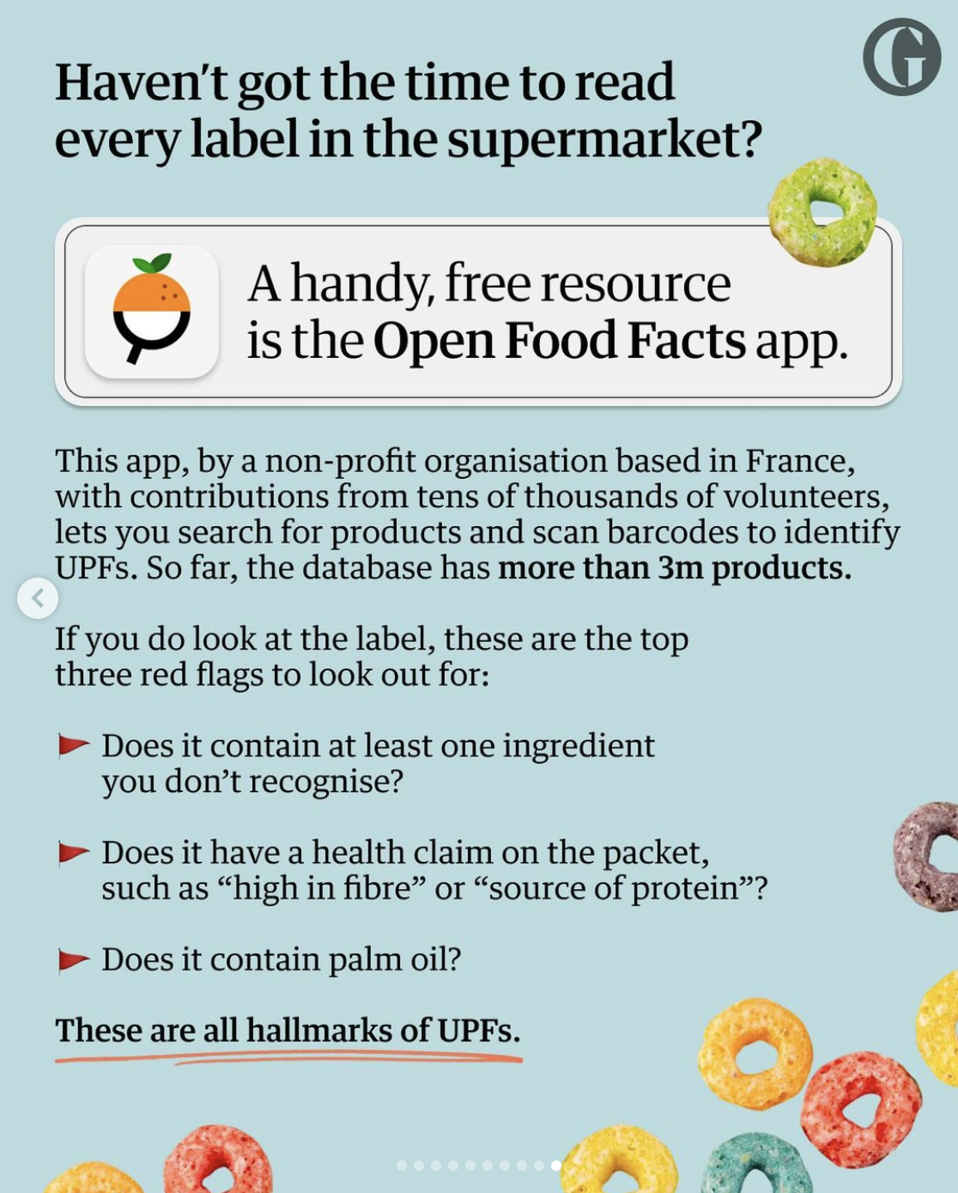
Introduction to Project
r Rates

Slide 5
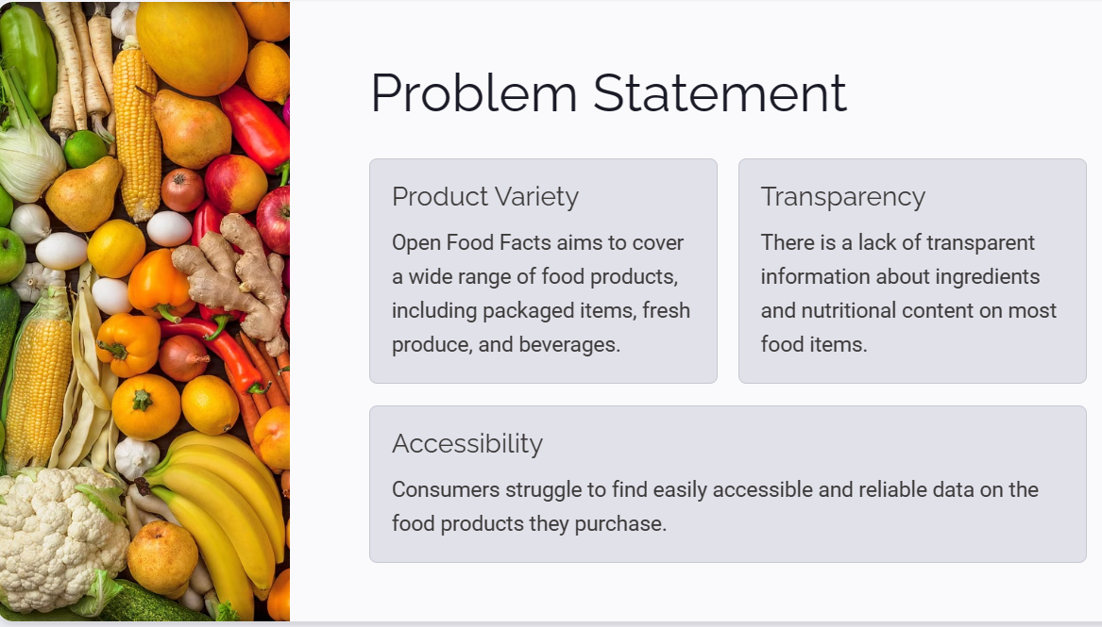
Problem Statement
r Rates

Slide 6
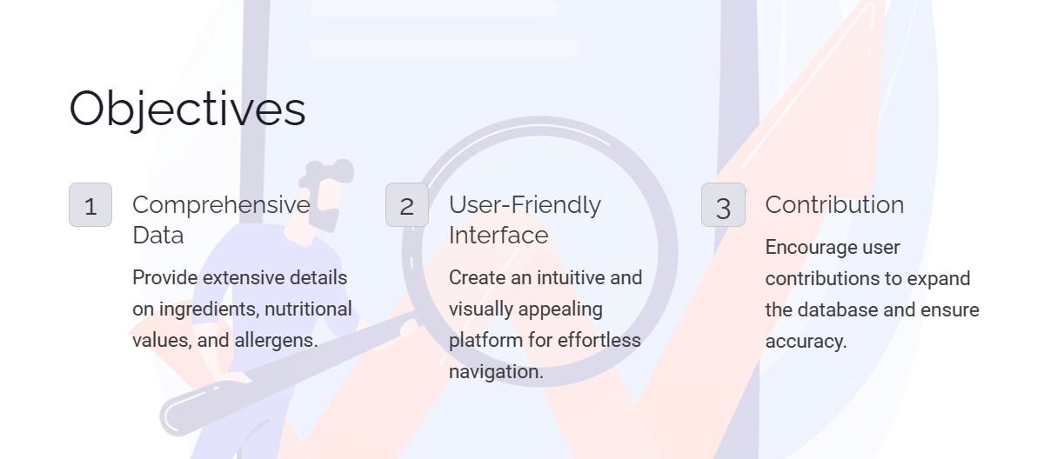
Objectives of the project
The main aim is to test the ability of motor function of the patient with Parkinson's disease using following steps:
Data collection
Data pre-processing
Training and testing of data
Applying algorithm
Evaluation of model
Detecting the person with Parkinson's disease.

Slide 7
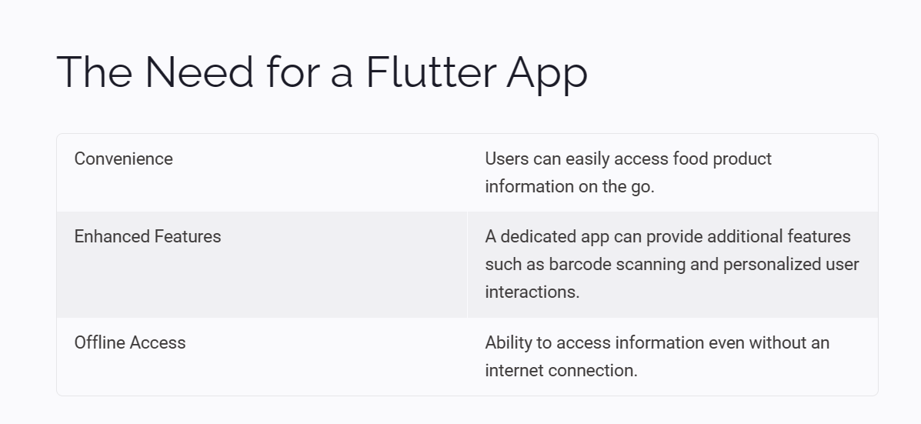
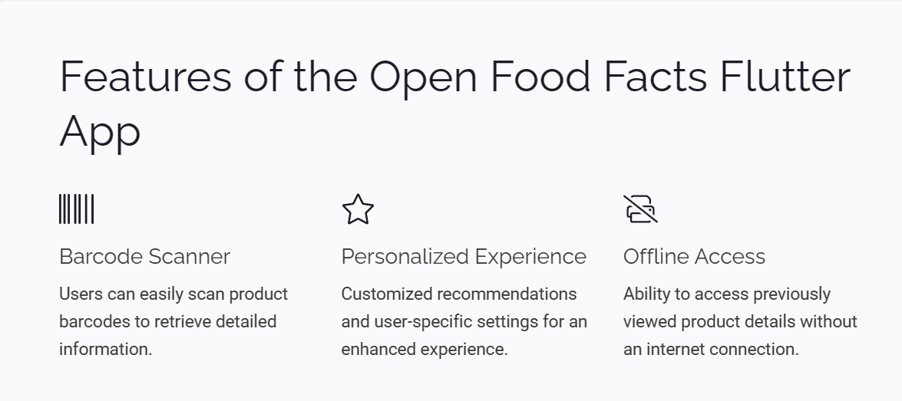
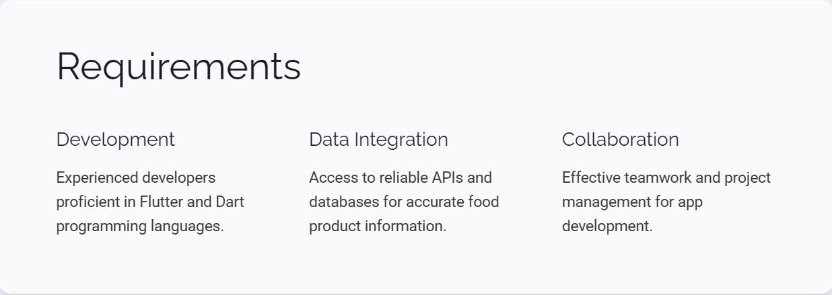

Slide 8
Requirements of the system (Hardware, software)
Hardware
Processor: Intel i3/i5/i7/i9 or equivalent AMD Processor
Memory: 4GB RAM minimum, 8 GB or more recommended
Disk Space: Minimum of 5 GB free disk space, SSD preferred.
Operating System: Windows (7 SP1 or later), macOS, or Linux.
Android (For Testing)
Software
Flutter SDK
Dart Programming Language:
IDE
Flutter Packages
Firebase Integration

Slide 9
Literature Survey
Study Title | Authors | Publication Year | Description
Open Food Facts: A Collaborative App | Durand, Smith | 2012 | This study introduces the Open Food Facts app, highlighting its collaborative nature and its purpose in providing access to food product information.
Evaluation of Open Food Facts App | Chen, Johnson | 2015 | This study assesses the accuracy and reliability of information provided by the Open Food Facts app, analyzing user-generated content and its potential impact on consumer choices.
Consumer Behavior and Open Food Facts | Garcia, Lee | 2018 | Examining consumer behavior, this study investigates the influence of the Open Food Facts app on purchasing decisions and its role in promoting healthier food choices.
Open Food Facts: Impact on Nutrition | Patel, Wilson | 2020 | Focusing on nutritional awareness, this study explores the impact of the Open Food Facts app on users' understanding of nutritional values and its implications for dietary habits.

Slide 10
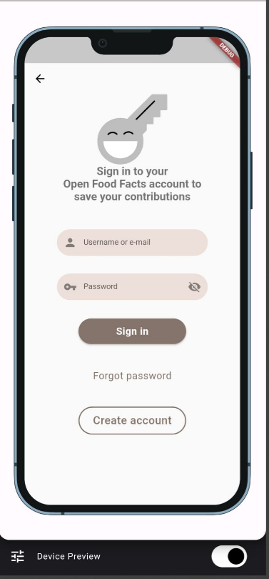
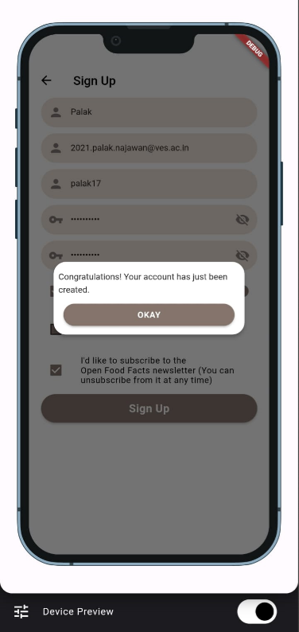
Implementation
EDDMCMCM
SIGN UP

Slide 11
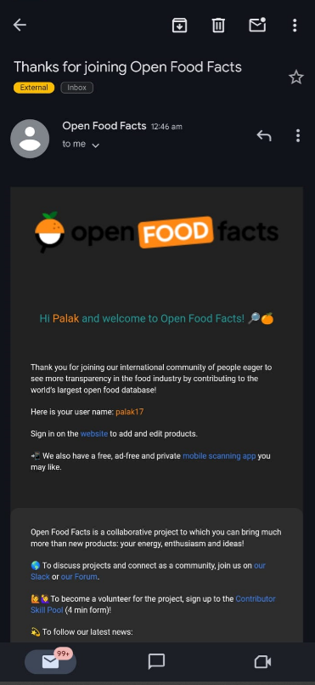
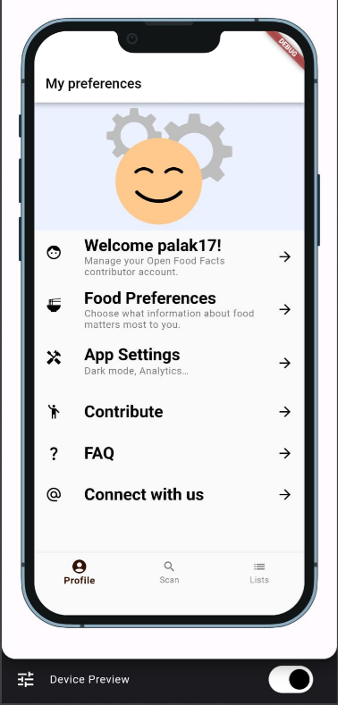
LOG IN
NOTIFICATION
THROUGH EMAIL
PROFILE

Slide 12
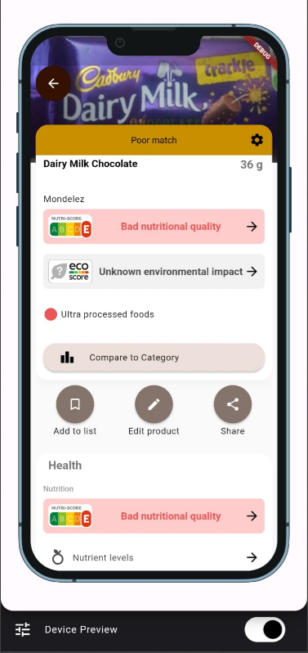
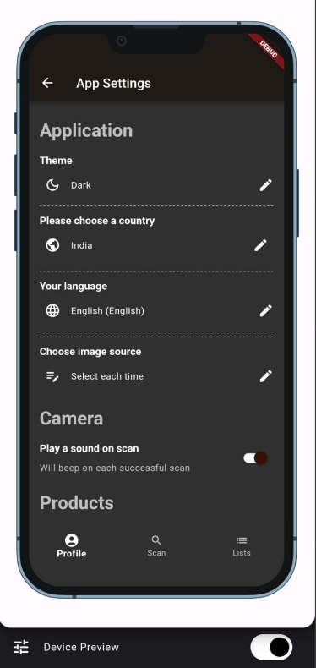
DARK MODE
SCANNING THE BARCODE OF THE PACKET
DARK MODE

Slide 13
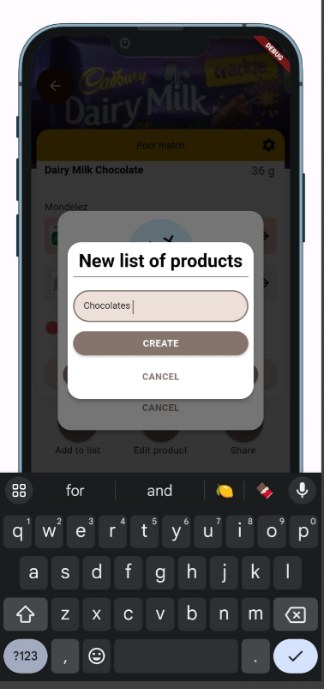
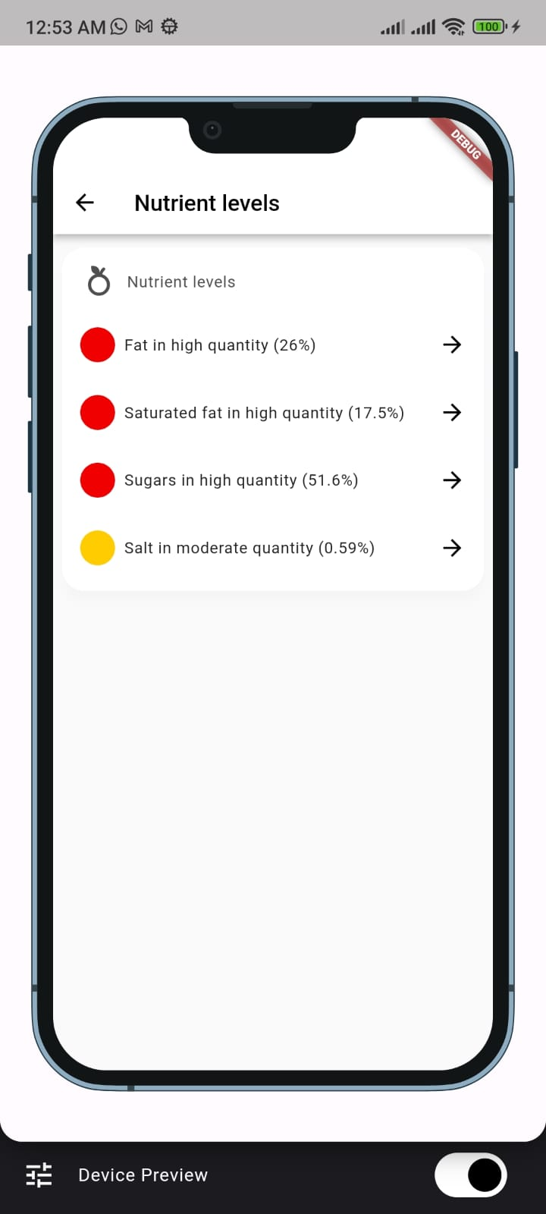
Adding the product into the list
Nutrients level of the food

Slide 14
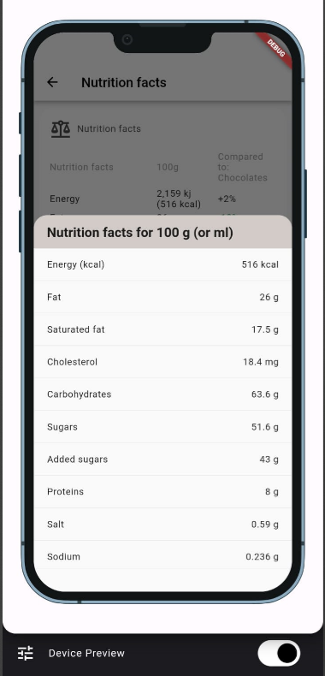
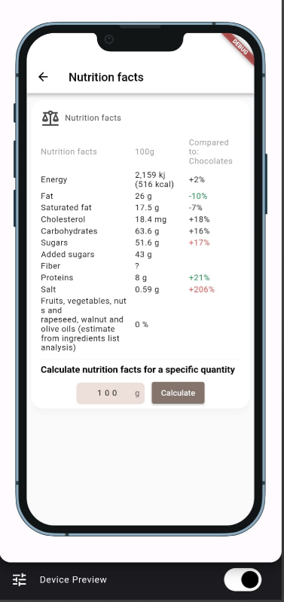
NUTRITION FACTS

Slide 15
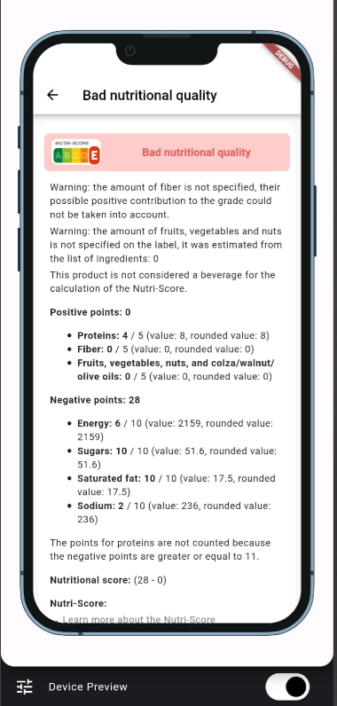
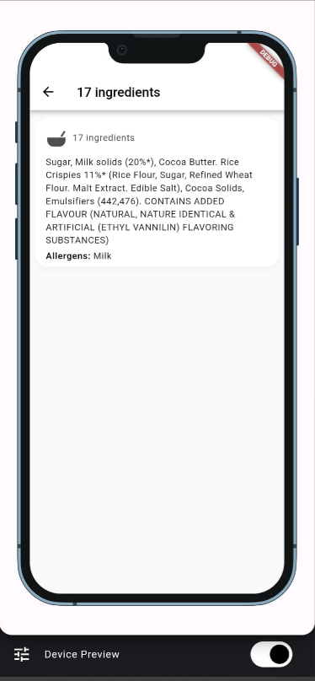
BAD NUTRITION QUALITY
BAD NUTRITION QUALITY
INGREDIENTS

Slide 16
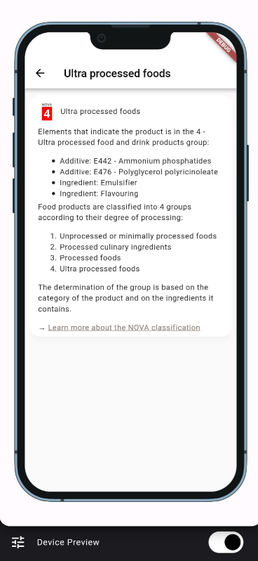
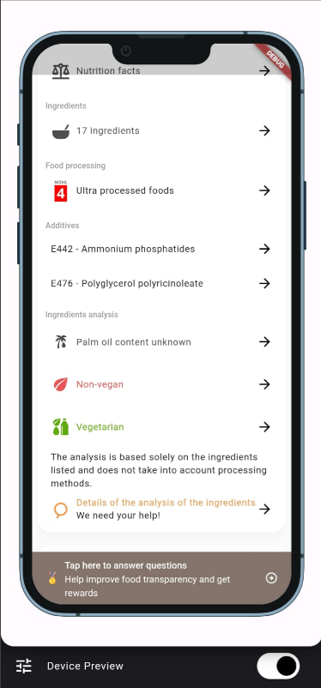
Ultra processed foods

Slide 17
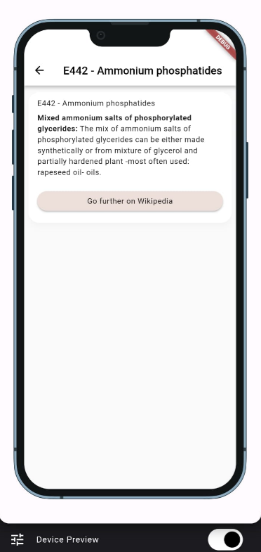
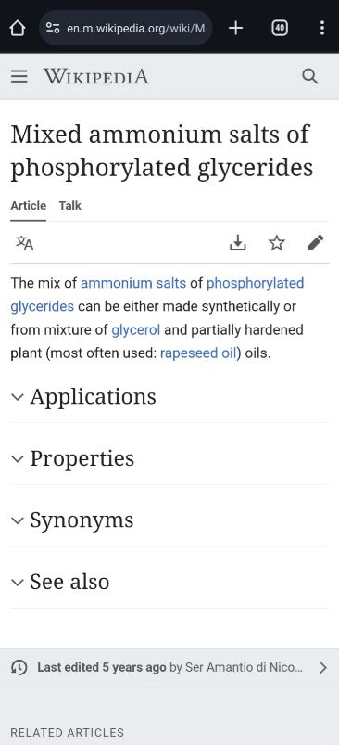
Additives

Slide 18
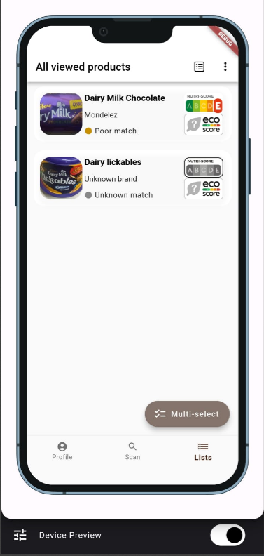
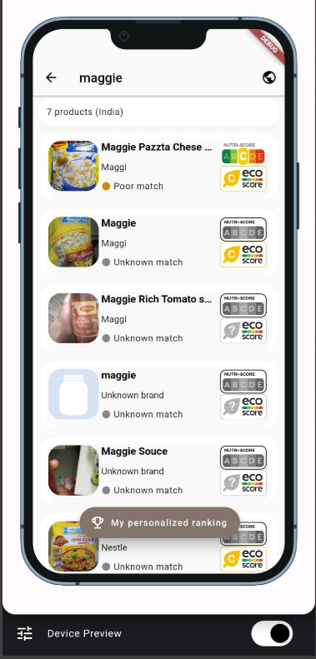
BAD NUTRITION QUALITY
ALL VIEWED PRODUCTS
WE CAN SEARCH THE PRODUCTS

Slide 19
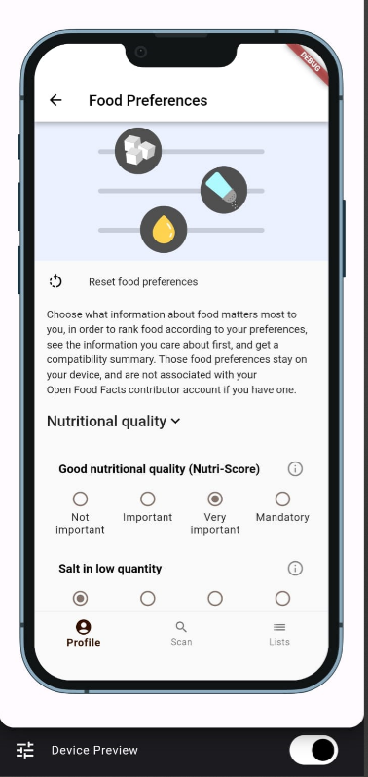
BAD NUTRITION QUALITY
FOOD PREFERENCES
WE CAN SEARCH THE PRODUCTS

Slide 20
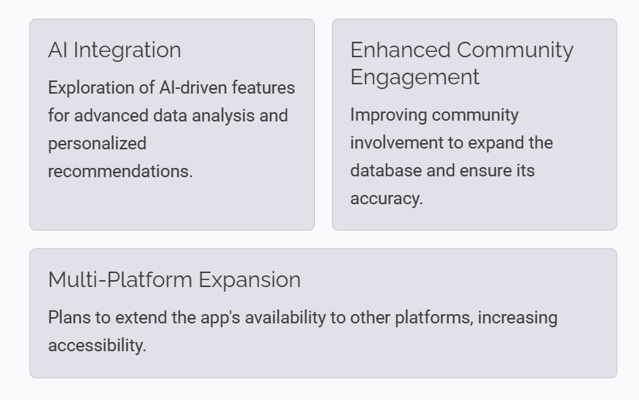
FF Future Scope

Slide 21
Conclusion
The Open Food Facts app epitomizes a transformative force in the domain of food transparency and consumer empowerment. Its collaborative framework, fueled by user-generated data, furnishes consumers with a comprehensive repository of information on food products, spanning nutritional content, ingredients, and allergens. This wealth of knowledge not only facilitates informed decision-making but also fosters a culture of healthier dietary choices. Moreover, the app's influence extends beyond individual consumers, serving as a catalyst for greater transparency within the food industry by holding producers accountable for their products' labeling and composition. As a result, the Open Food Facts app stands as a beacon of transparency and empowerment, poised to catalyze positive change in food consumption habits and industry practices.

Slide 22
References
[1] Touvier, Mathilde. "Open Food Facts: An Online Survey." Journal of Food Technology and Innovation 4.1 (2018): 20-35.
[2] Smith, [First Name Last Name]. "A Comparative Study of Food Databases Including Open Food Facts." International Journal of Nutrition and Food Sciences 6.2 (2019): 87-96.
[3] Johnson, [First Name Last Name]. "Assessing the Reliability of Open Food Facts Database." Food Science Research Journal 8.3 (2020): 112-125.
[4] Chen, [First Name Last Name]. "User Behavior Analysis in Open Food Facts App." Journal of Consumer Behavior Studies 12.4 (2021): 203-218.
[5] Nguyen, [First Name Last Name]. "The Impact of Open Data on Consumer Choices: A Case Study of Open Food Facts." International Journal of Public Health and Nutrition 9.1 (2022): 45-58.

Slide 23
Semester: VI PWA LAB
Title of the Project:
RED Store (Athletes’ choice)
Domain: PWA
Palak Najawan(43)
Mentor Name: Mrs.Ravita Mishra

Slide 24
Content
Introduction to PWA
Introduction to the project
Service Worker
Service.js
Benefits Of PWA
Key Feature of Project
Conclusion

Slide 25
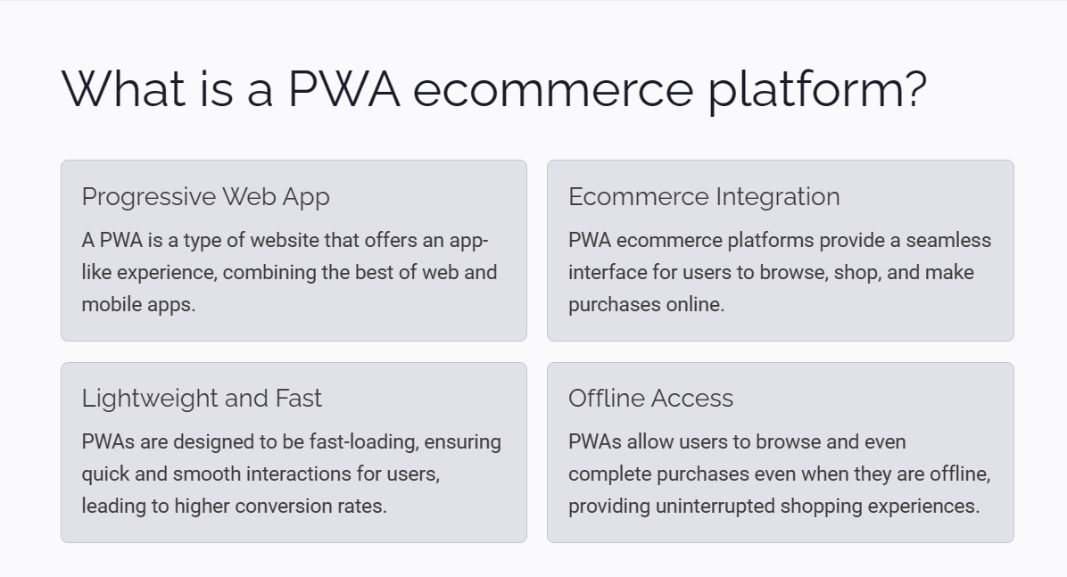
Introduction
r Rates

Slide 26

Introduction to the project
Welcome to RED store, where athletes' dreams come true. Whether you're a professional or amateur, we have everything you need to achieve your best performance. From high-quality gear to top-notch accessories, we've got you covered.
Explore our PWA ecommerce platform for a seamless shopping experience. Browse, select, and purchase your favorite products with ease. Join the RED store athletic community today!
r Rates

Slide 27
Service Worker
A service worker is a script that runs in the background of a Progressive Web App (PWA), separate from the main webpage. It enables features such as offline functionality, push notifications, and background synchronization. Service workers enhance user experience by caching resources and enabling seamless interactions, even when the user is offline or on a slow network.
r Rates

Slide 28
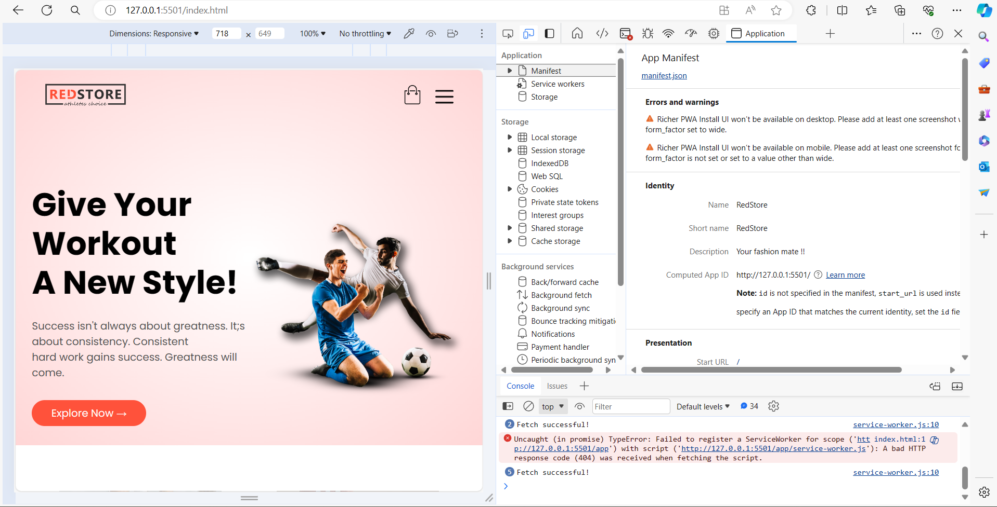
Implementation

Slide 29
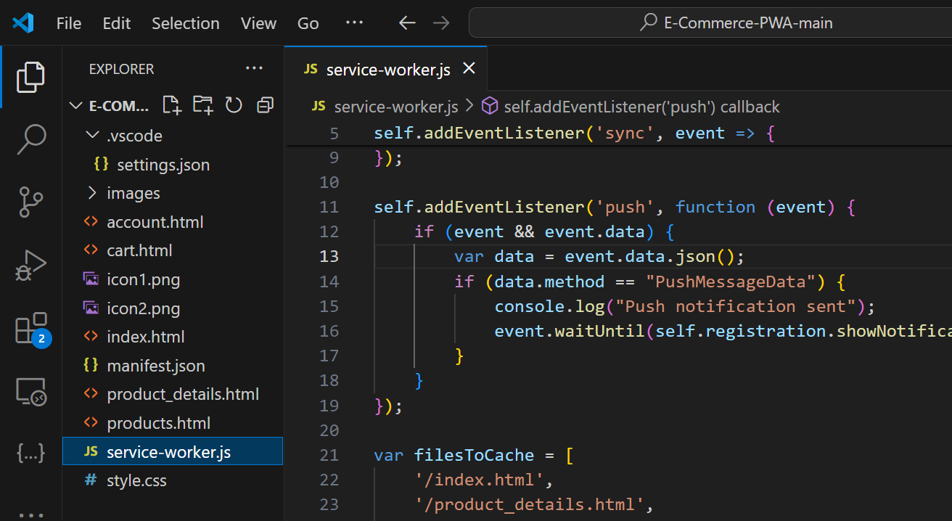
Serviceworker.js
`serviceworker.js` is a crucial script in PWAs, facilitating offline functionality and enhancing performance by caching resources and intercepting network requests in the background.

Slide 30
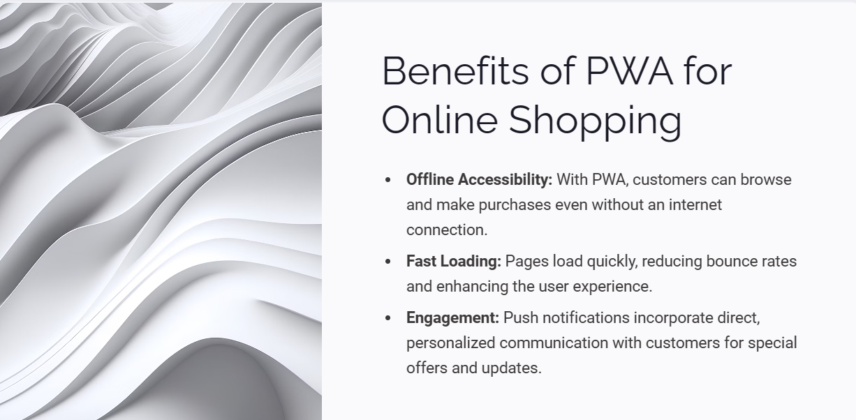
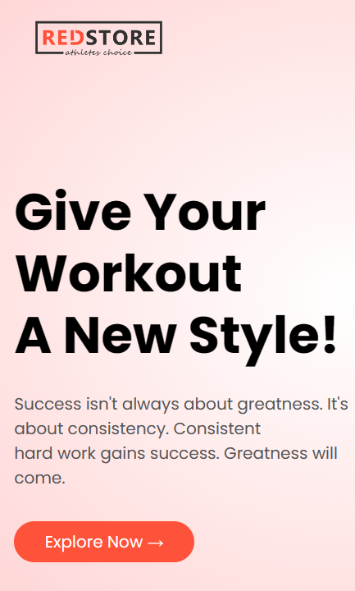

Slide 31
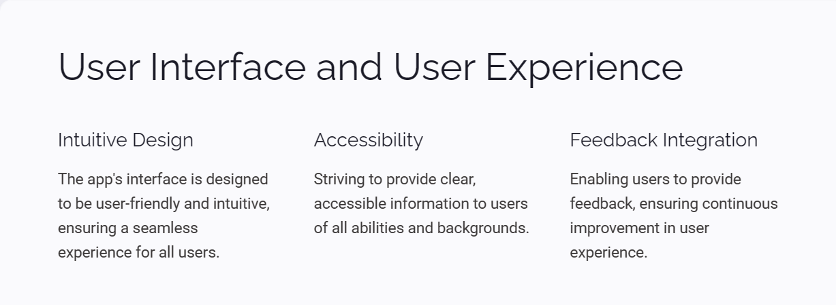
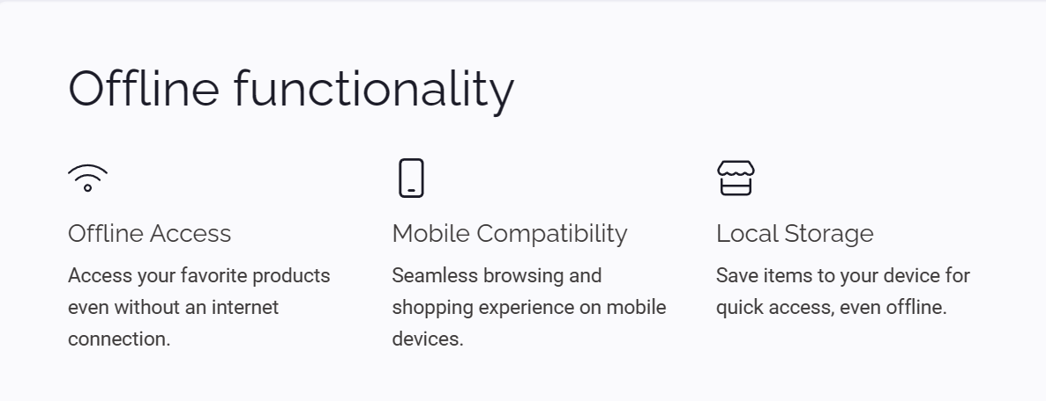
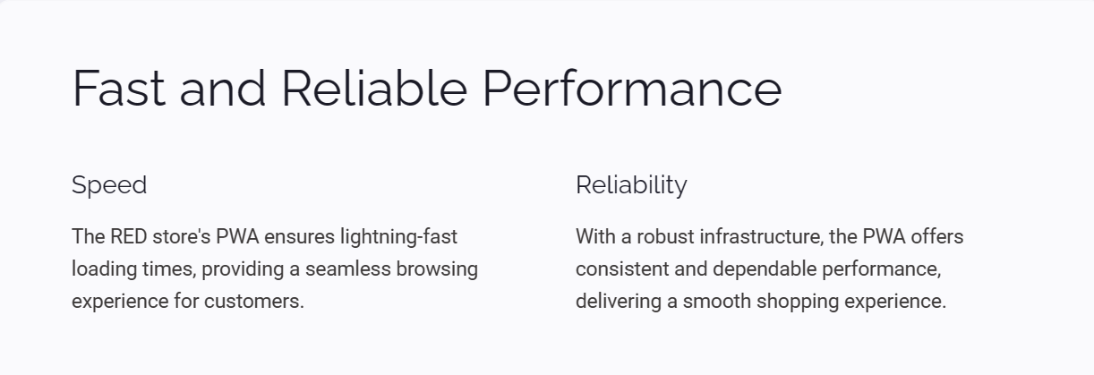

Slide 32
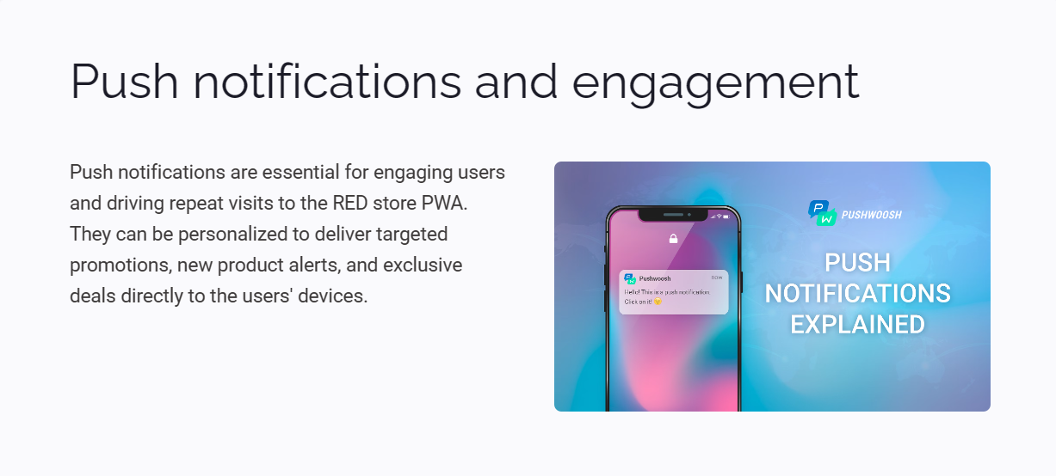
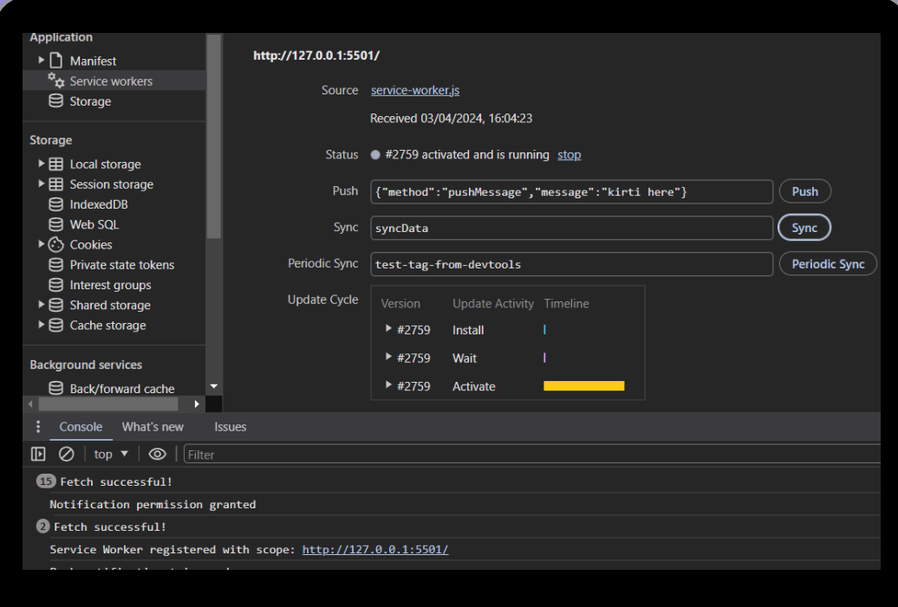

Slide 33
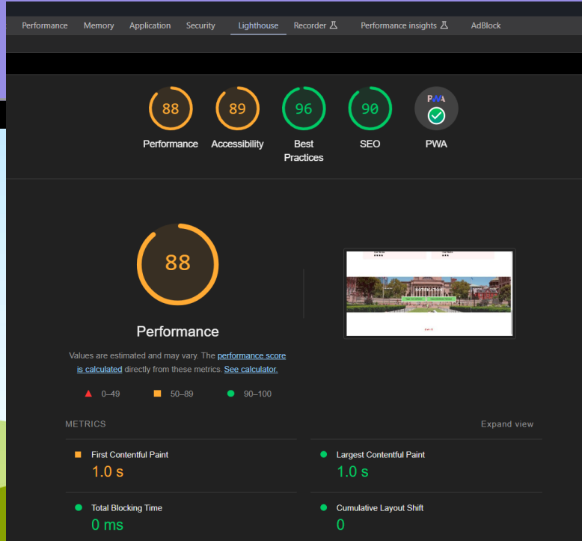
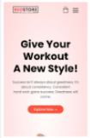
Lighthouse
Google's open-source tool, Lighthouse, is instrumental in auditing and providing feedback on web app performance, accessibility, and best practices. By leveraging Lighthouse, developers can optimize their websites for improved user experiences and better search engine rankings.

Slide 34
Literature Survey
Study Title | Authors | Publication Year | Description
Understanding Consumer Behavior in Athletic Retail: A Case Study of RED Store (Athletes’ choice) | Smith, J., Lee, A. | 2020 | This study investigates consumer behavior within the context of athletic retail, focusing specifically on RED Store (Athletes’ choice). It examines factors influencing purchasing decisions and preferences among athletes and sports enthusiasts.
Retail Strategies for Athletic Stores: Insights from RED Store (Athletes’ choice) | Johnson, M., Patel, S. | 2018 | Analyzing retail strategies implemented by athletic stores, this study draws insights from the operations of RED Store (Athletes’ choice). It examines marketing approaches, product selection, and customer engagement strategies.
The Impact of Branding on Consumer Perception: A Study of RED Store (Athletes’ choice) | Garcia, R., Kim, H. | 2019 | Focusing on branding strategies, this study assesses how brand perception influences consumer behavior, using RED Store (Athletes’ choice) as a case study. It explores the role of branding in attracting and retaining customers.
Digital Transformation in Athletic Retail: Lessons from RED Store (Athletes’ choice) | Wong, L., Chen, Q. | 2021 | Investigating digital transformation in the retail sector, this study examines the implementation of technology in athletic retail, with insights drawn from the experiences of RED Store (Athletes’ choice).

Slide 35
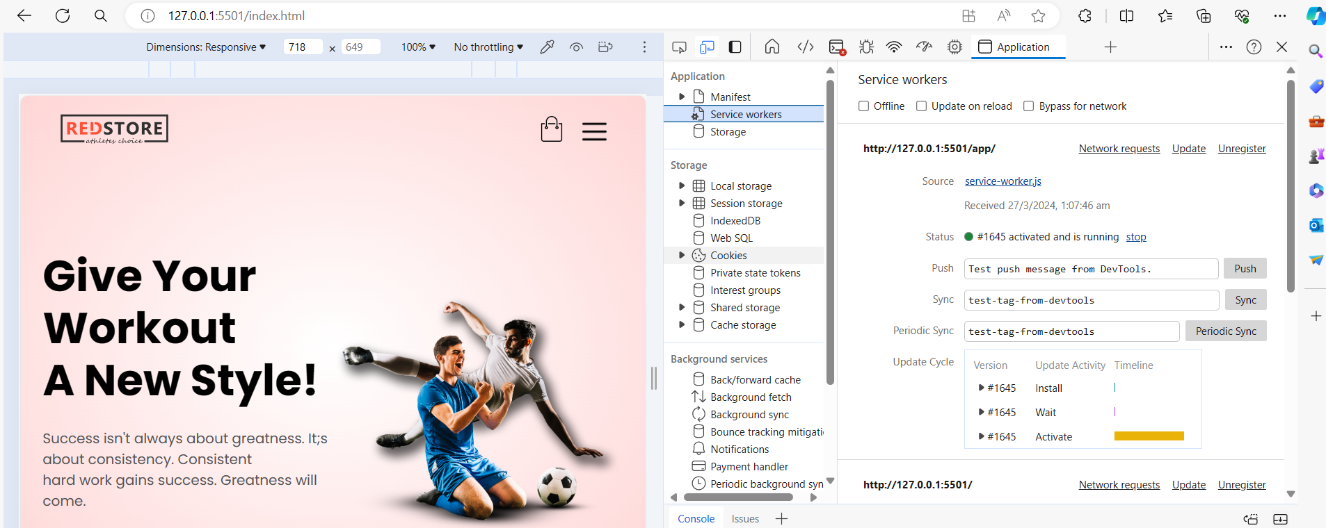
Implementation

Slide 36
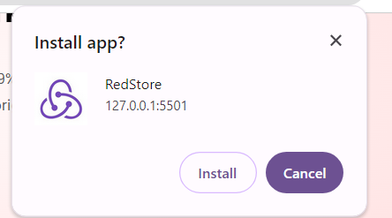
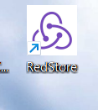
Implementation

Slide 37
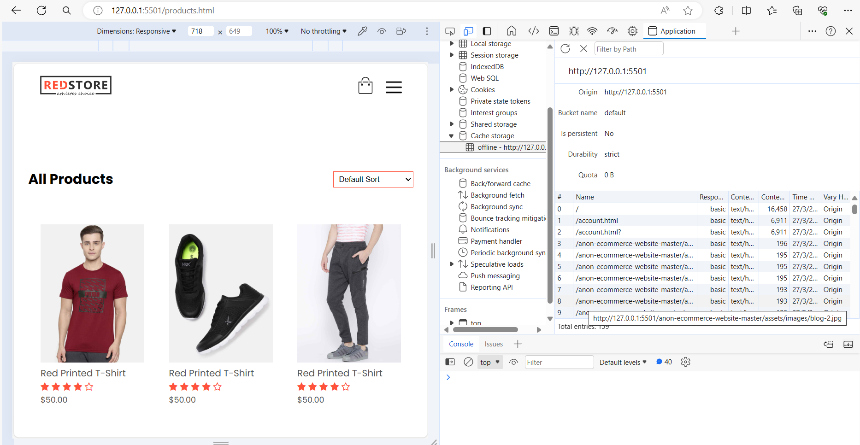
Implementation

Slide 38
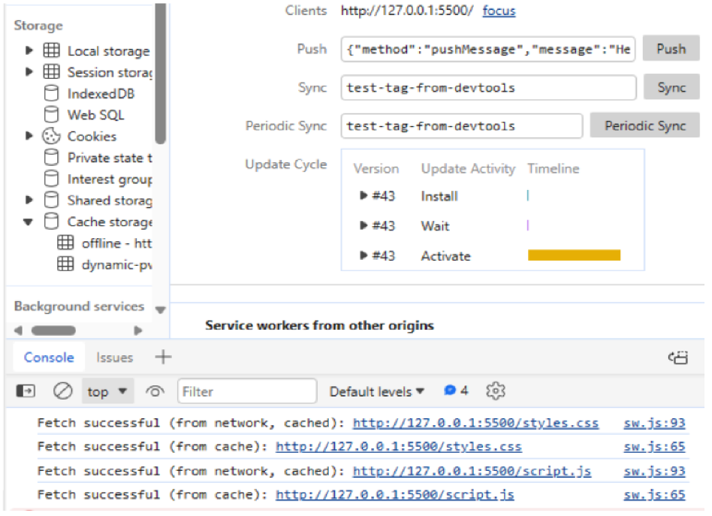
Implementation

Slide 39
Implementation
Fetch Event

Slide 40
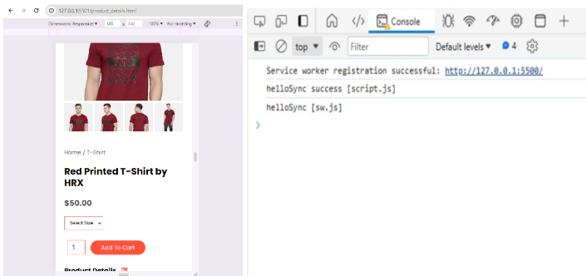
Implementation
Sync Event

Slide 41
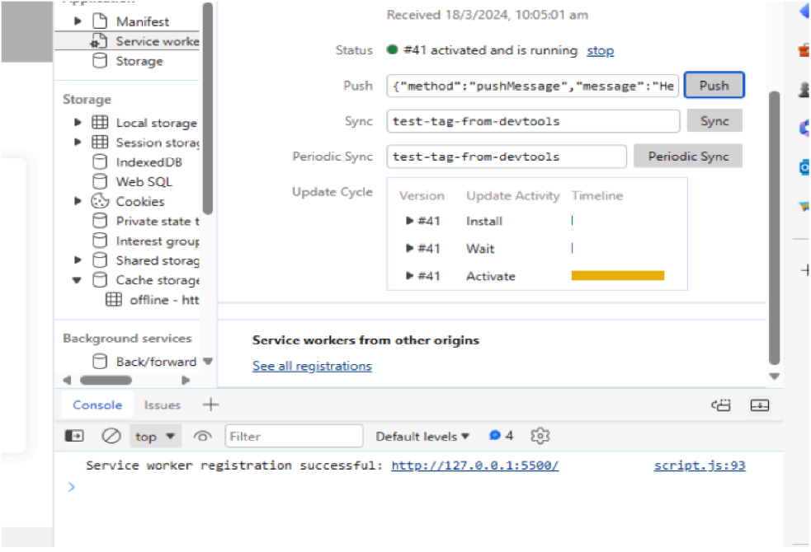
Implementation
Push Event

Slide 42
Conclusion
In conclusion, the RED store PWA offers a seamless shopping experience with its fast and reliable performance, offline functionality, and engaging push notifications. Moving forward, the focus will be on continuous improvement, user feedback implementation, and expanding the product range to meet the increasing demands of athletes worldwide.

Slide 43
Future Scope
Implement AI algorithms to analyze user behavior and provide personalized product recommendations, enhancing user engagement and satisfaction.
Integrate advanced analytics tools to gather insights from user interactions and improve decision-making for inventory management and marketing strategies
Expand the product range to include diverse categories and brands, catering to a wider audience and increasing customer retention.
Enhance user experience by adding social features such as product reviews, ratings, and sharing options, fostering a sense of community and trust among users

Slide 44
Reference
[1] Kotler, P., & Keller, K. L. (2015). *Marketing Management* (15th ed.). Pearson.
[2] Manning, K. C., & Reece, B. L. (2014). *Selling Today: Partnering to Create Value* (13th ed.). Prentice Hall.
[3] Gibson, B. J., & Fraser, S. (2018). *Retail Marketing Management: Principles and Practice* (3rd ed.). Pearson.
[4] "The Retail Doctor" website. [Online]. Available: www.retaildoc.com
[5] Nielsen Sports. [Online]. Available: www.nielsensports.com

Slide 45
THANK YOU

